Slide 1
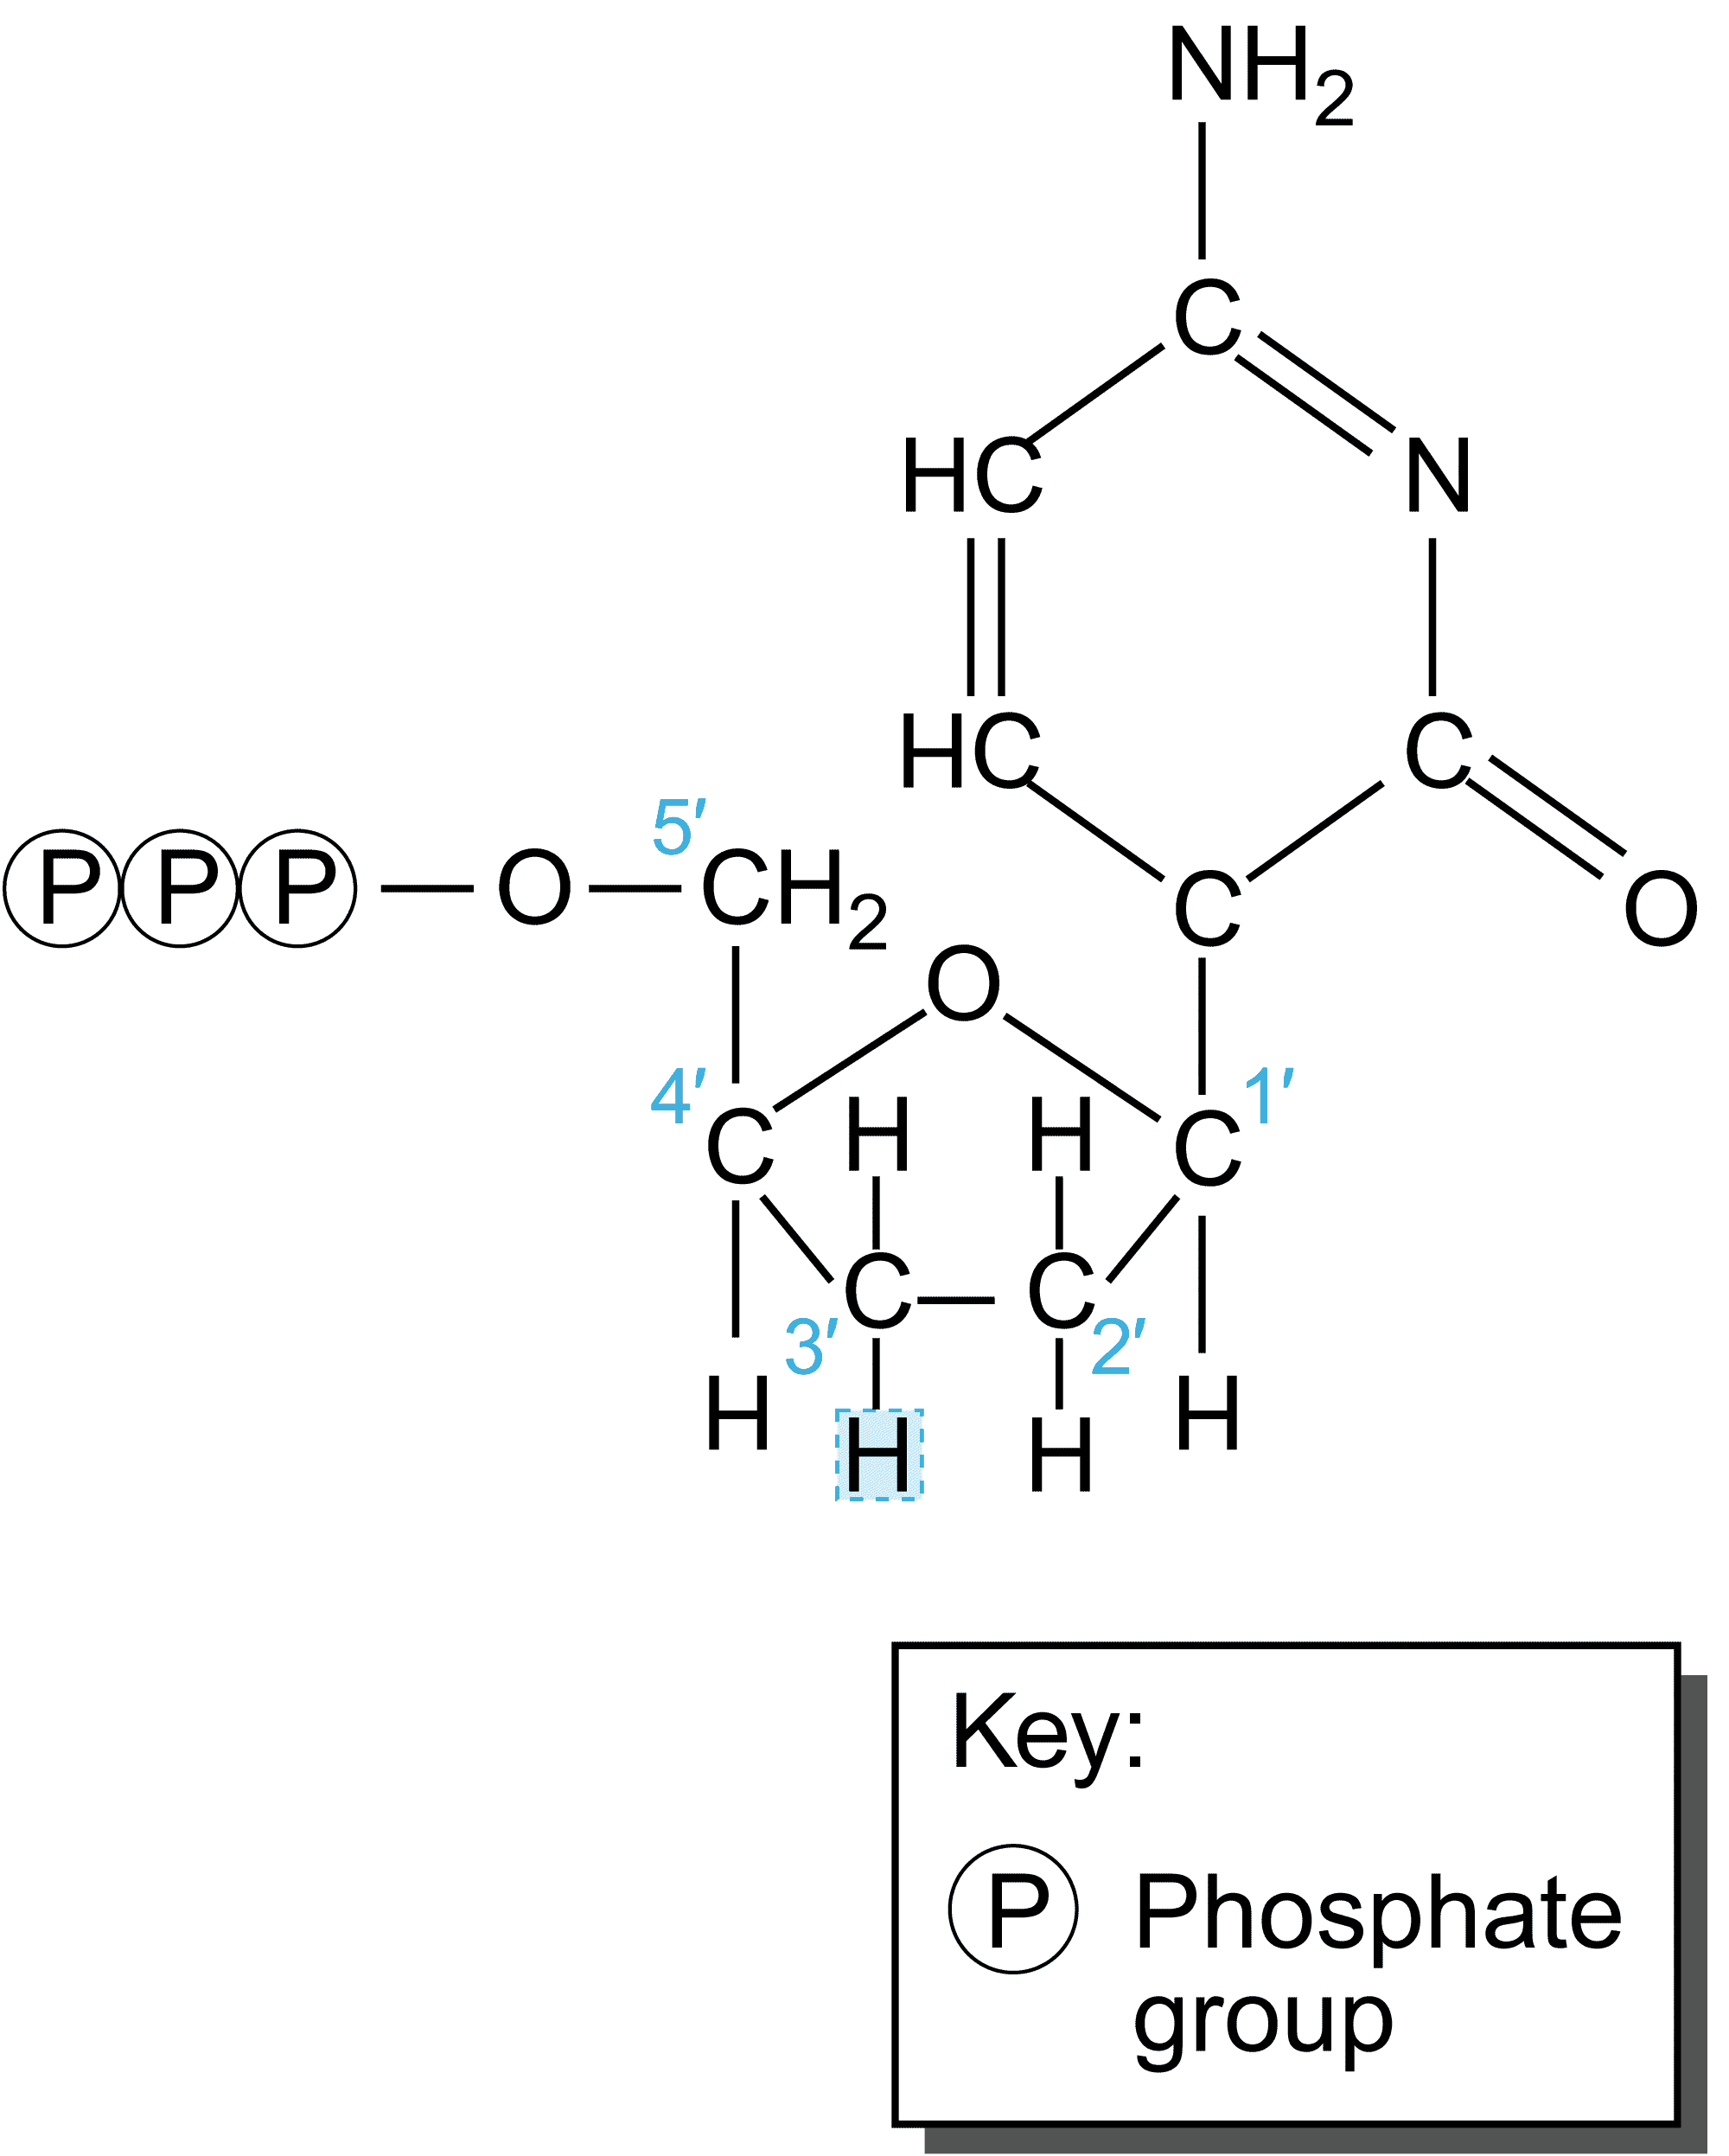
Sequenziamento: metodo di Sanger con ddNTP

Slide 2
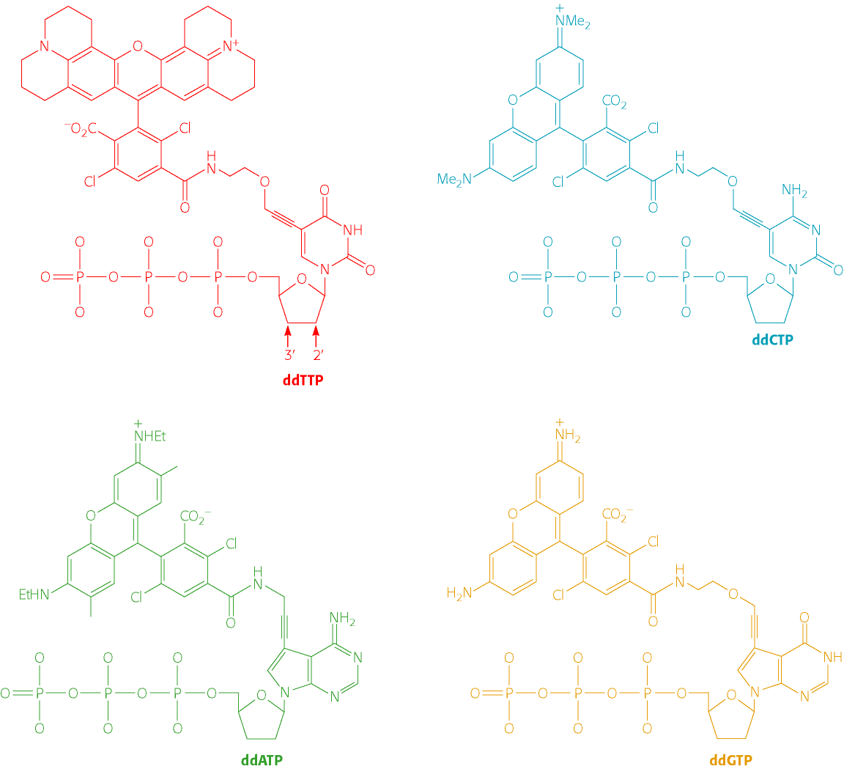

Slide 3
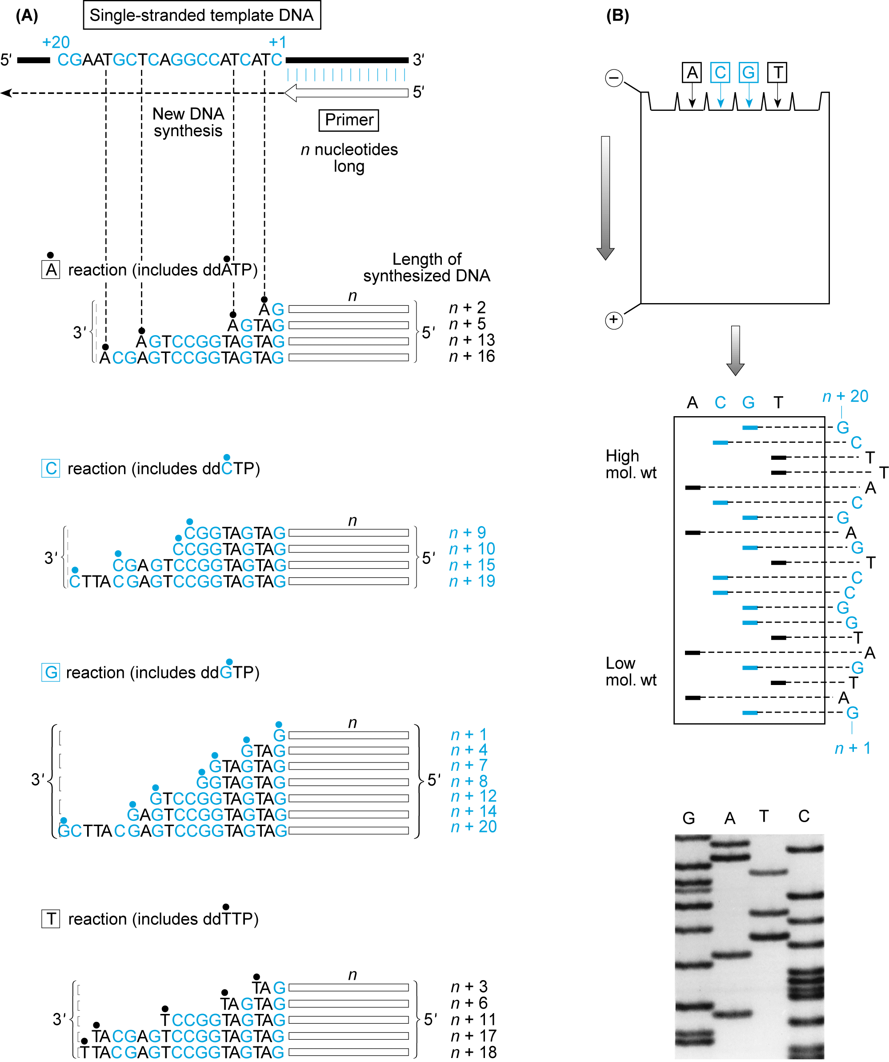
Sequenziamento con dideossonucleotidi

Slide 4
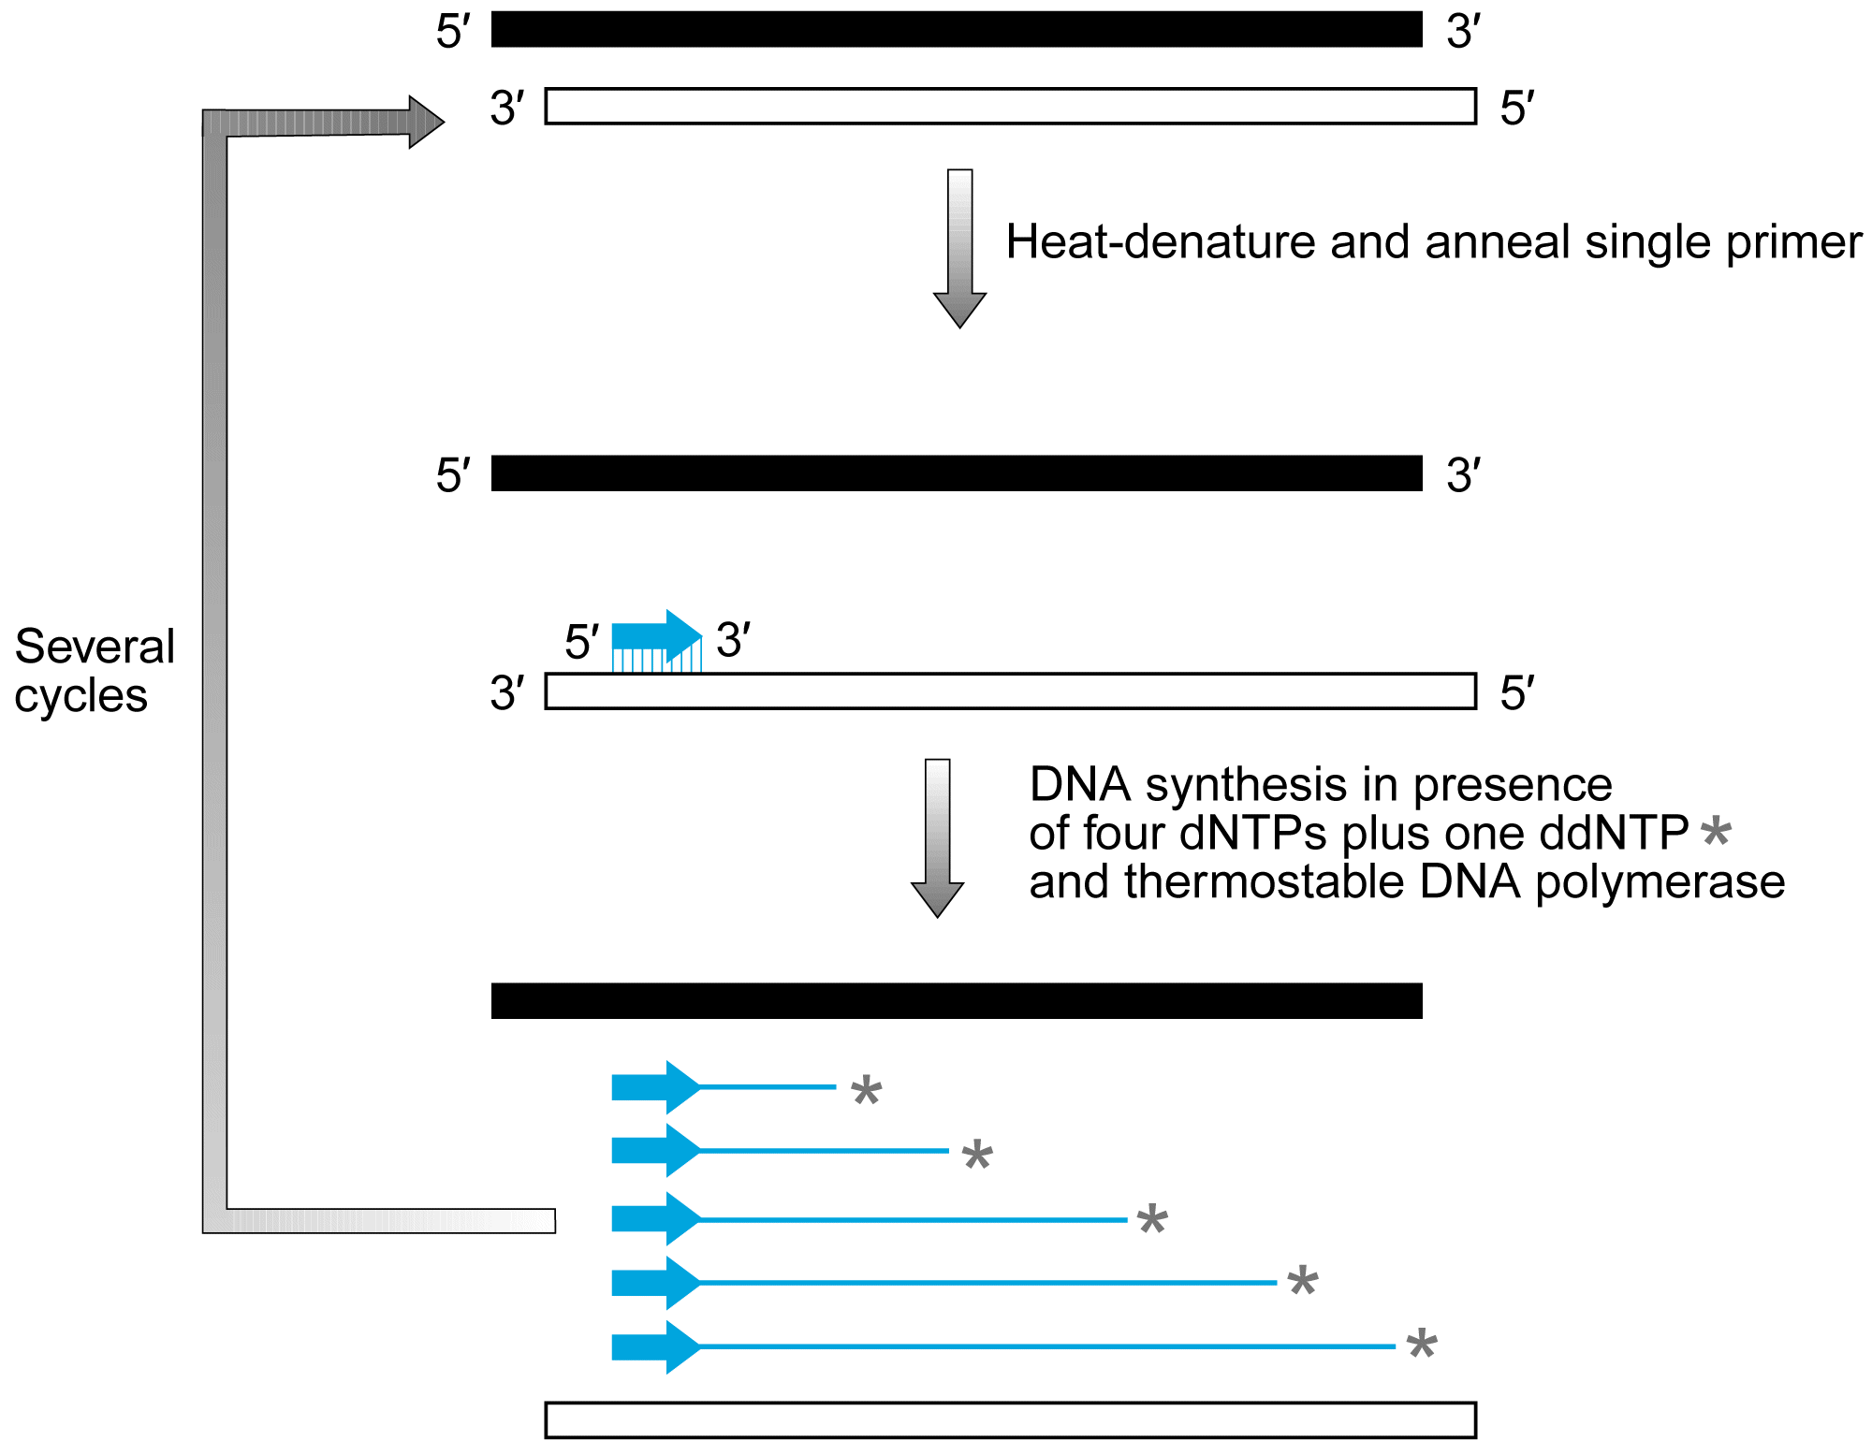

Slide 5
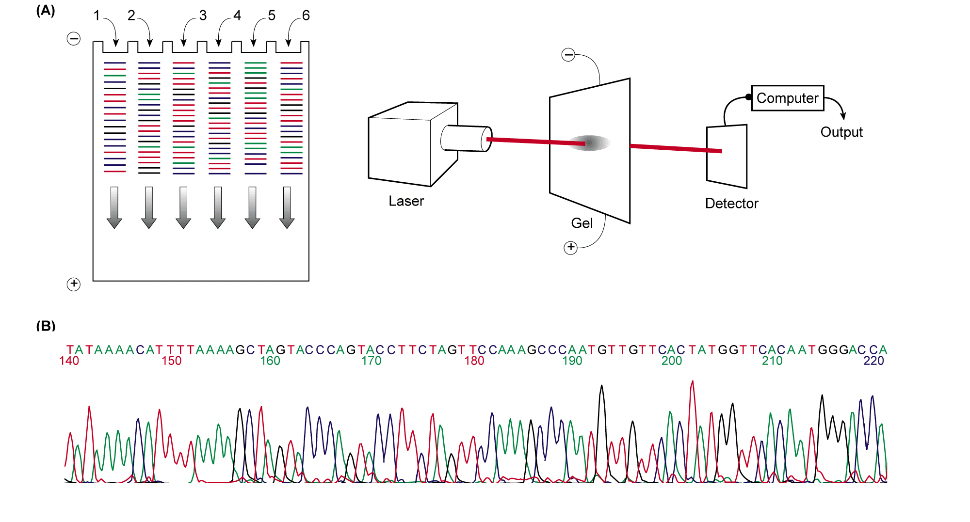
Sequenziamento automatizzato del DNA

Slide 6
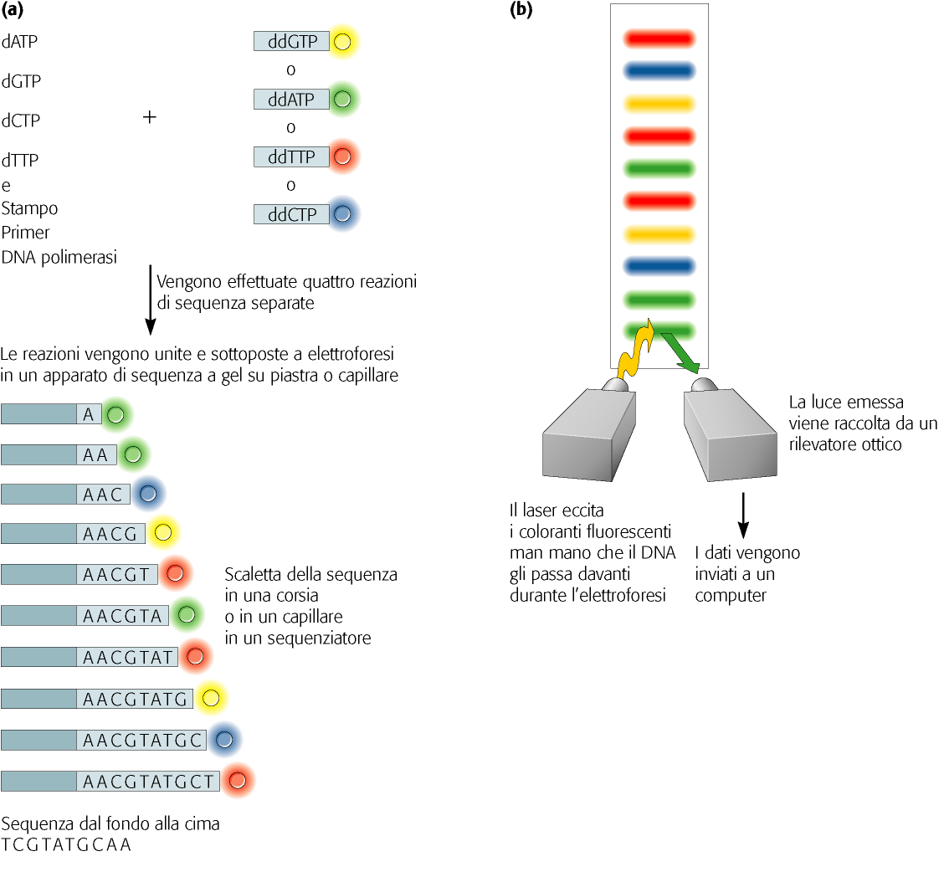

Slide 7
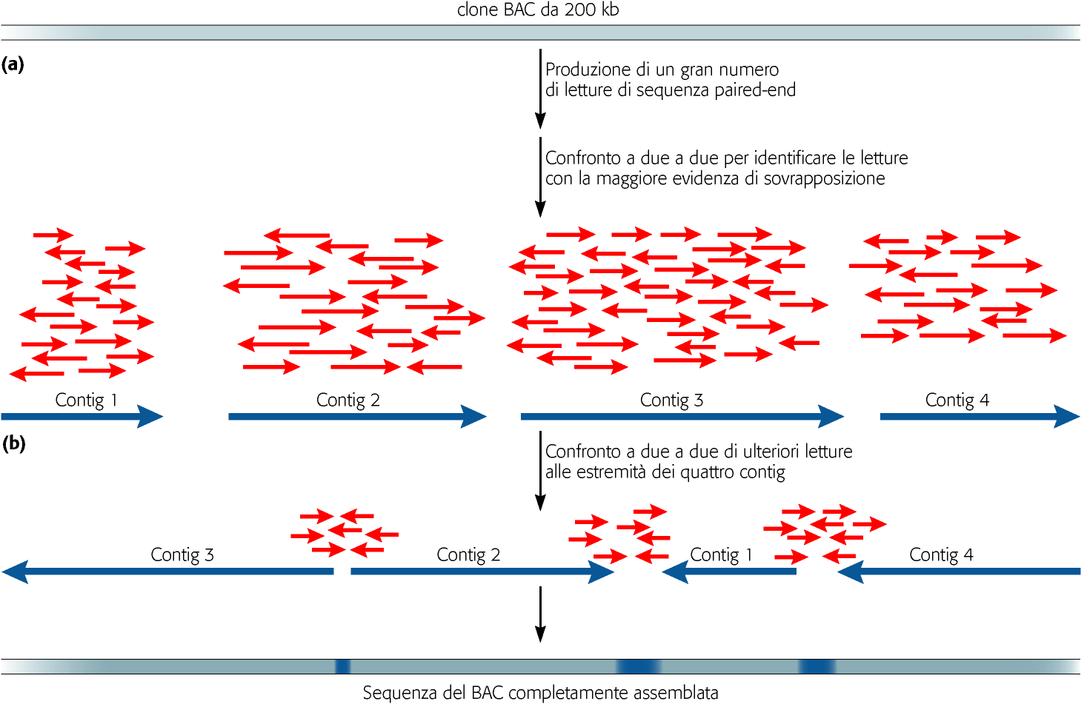

Slide 8
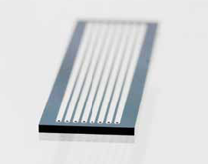
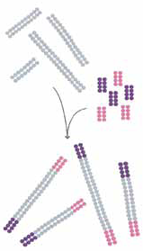
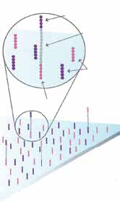
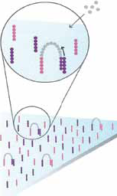
Figure 1: Illumina Flow Cell
Figure 2: Prepare Genomic DNA Sample
DNA
Adapters
Figure 3: Attach DNA to Surface
Figure 4: Bridge Amplification
Adapters
DNA
Dense lawn
of primers

Slide 9
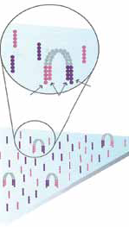
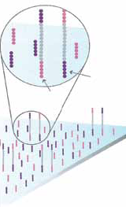
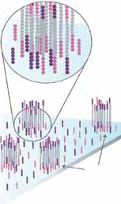
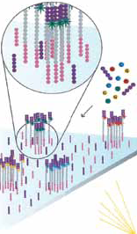
Figure 5: Fragments Become Double Stranded
Figure 6: Denature the Double-Standed Molecules
Attached
terminus
Attached
terminus
Free
terminus
Attached
Attached
Figure 7: Complete Amplification
Figure 8: Determine First Base
Clusters
Laser

Slide 10

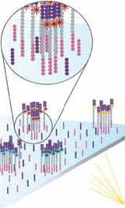


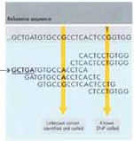
Figure 9: Image First Base
Figure 10: Determine Second Base
Figure 11: Image Second Chemistry Cycle
Figure 12: Sequencing Over Multiple Chemistry Cycles
Figure 13: Align Data
Laser
GCTGA...

