Slide 1
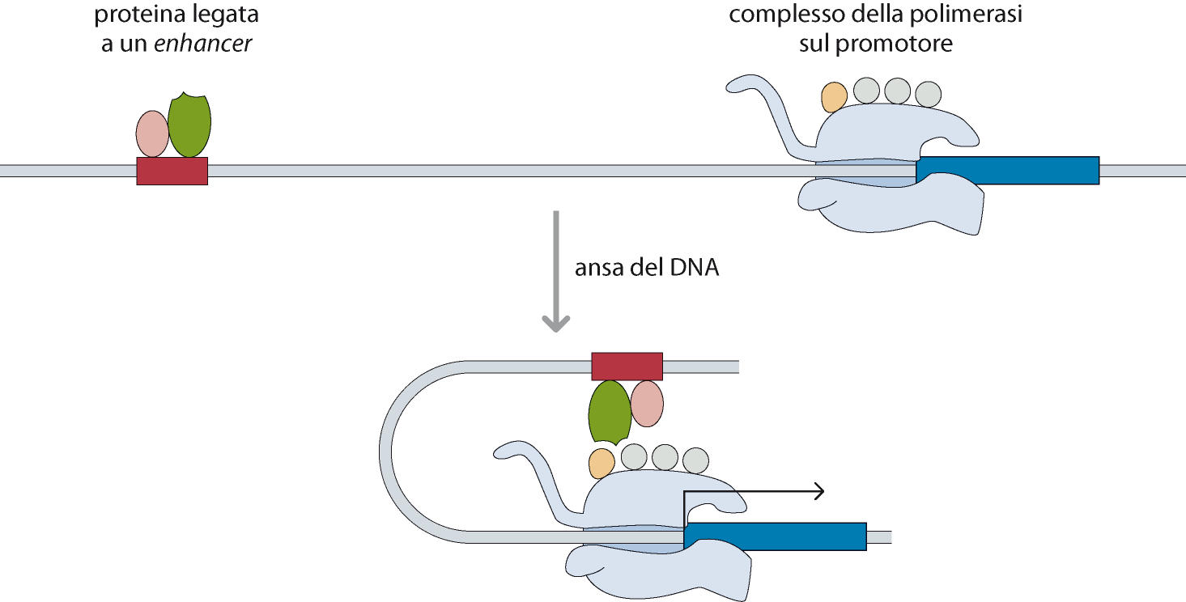

Slide 2
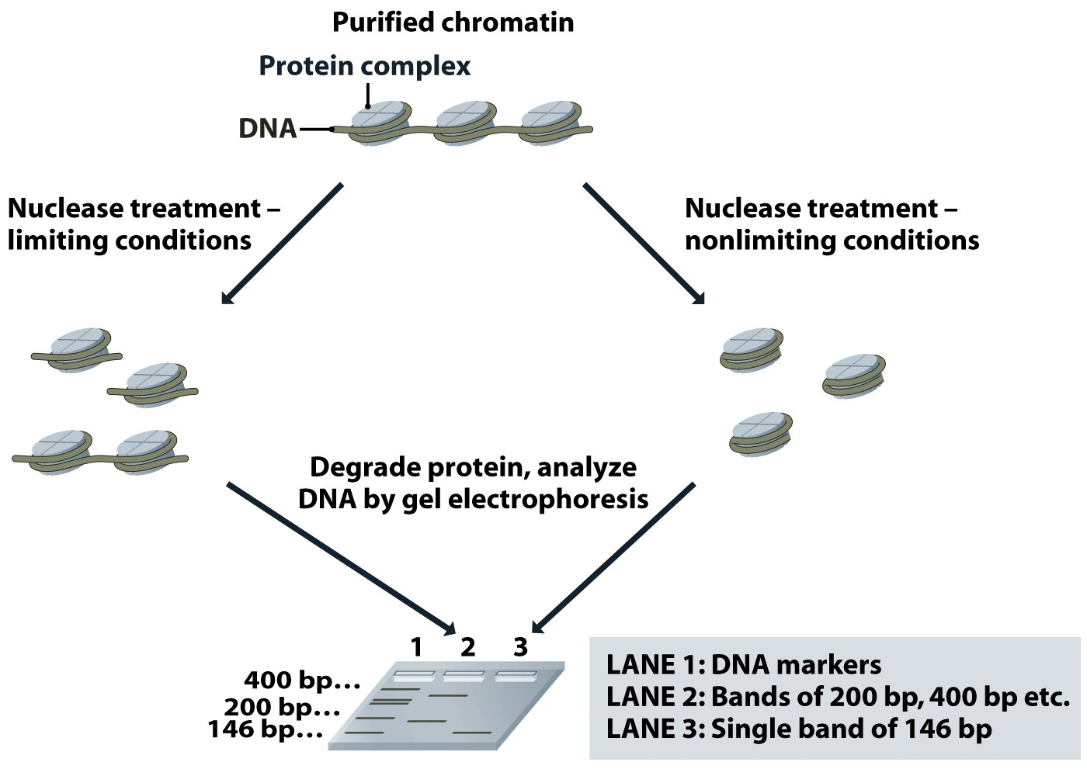
Figure 7.1 Genomes 3 (© Garland Science 2007)

Slide 3
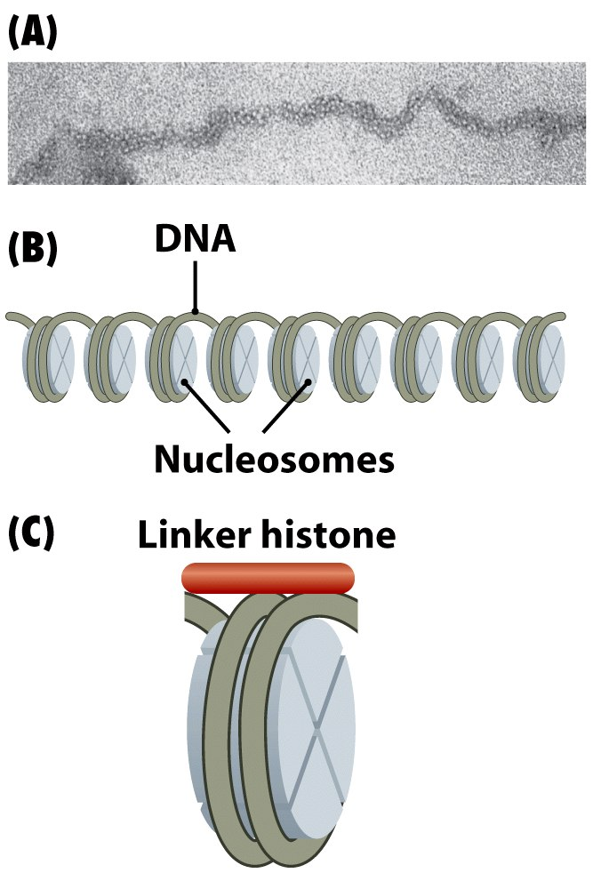
Figure 7.2 Genomes 3 (© Garland Science 2007)

Slide 4
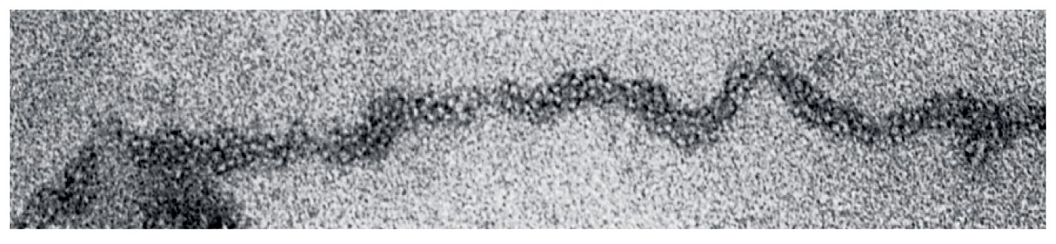
Figure 7.2a Genomes 3 (© Garland Science 2007)

Slide 5
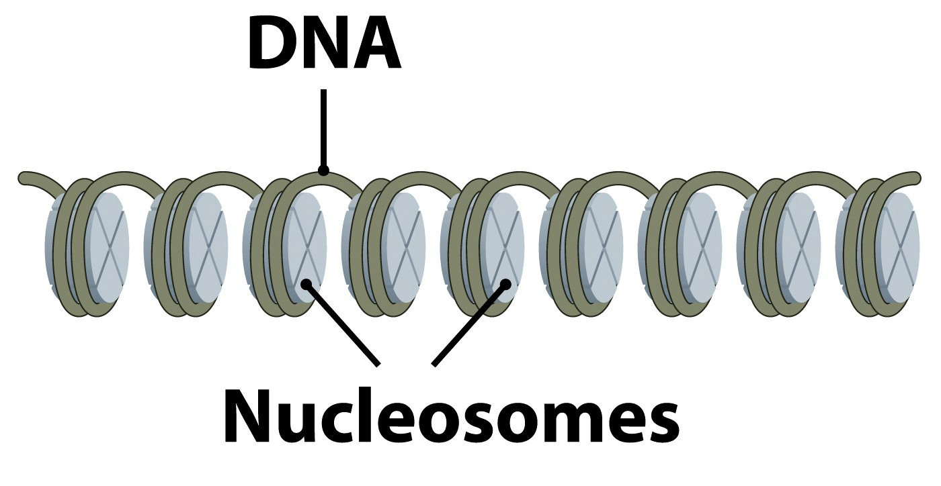
Figure 7.2b Genomes 3 (© Garland Science 2007)

Slide 6
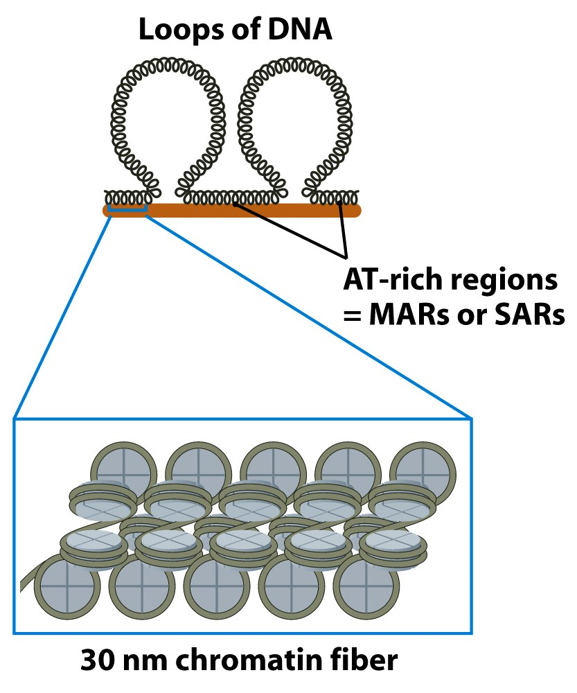
Figure 10.5 part 3 of 3 Genomes 3 (© Garland Science 2007)

Slide 7
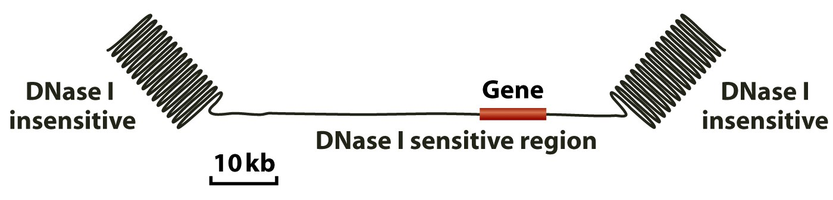
Figure 10.6 Genomes 3 (© Garland Science 2007)

Slide 8
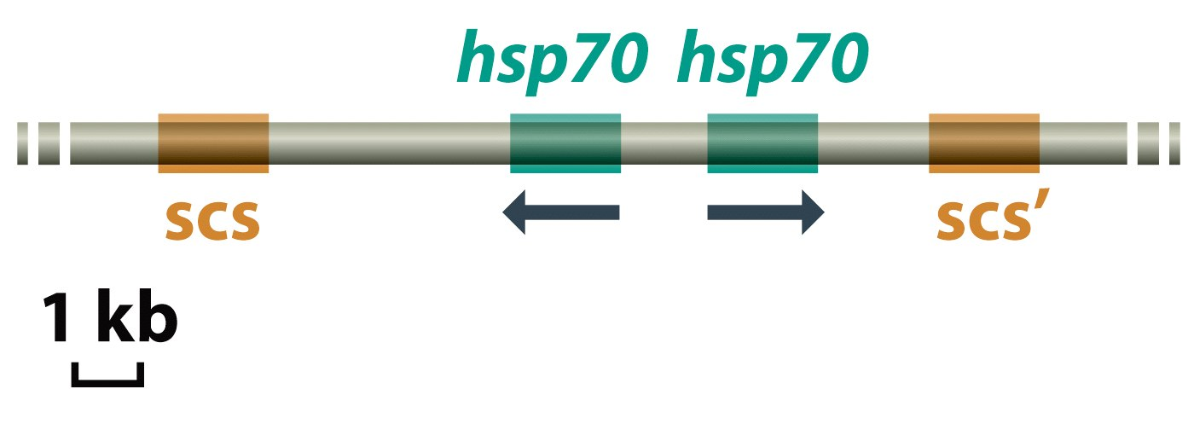
Figure 10.7 Genomes 3 (© Garland Science 2007)

Slide 9
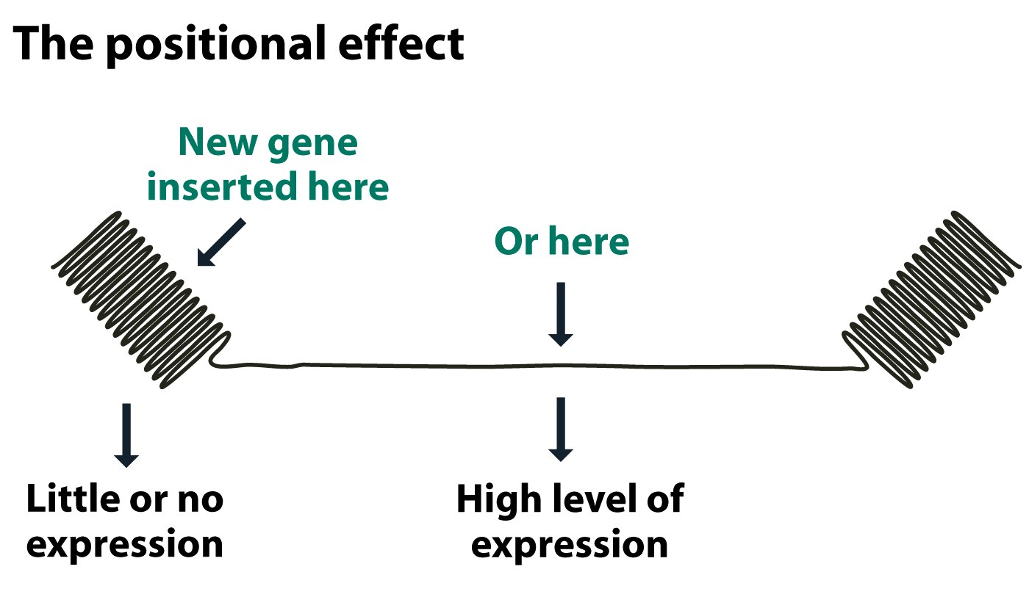
Figure 10.8a Genomes 3 (© Garland Science 2007)

Slide 10
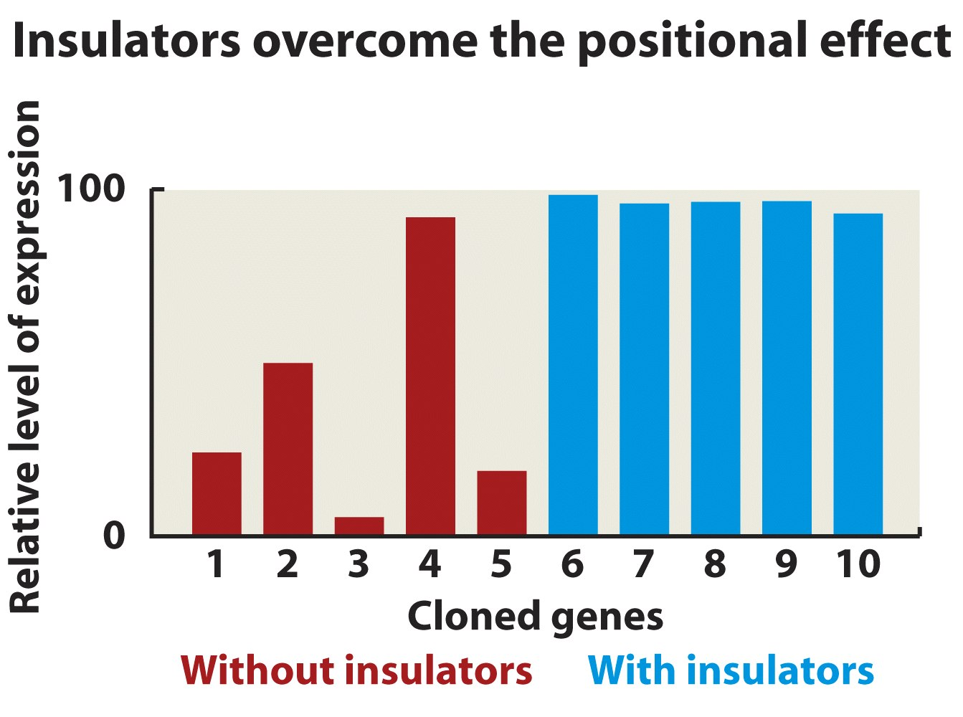
Figure 10.8b Genomes 3 (© Garland Science 2007)

Slide 11
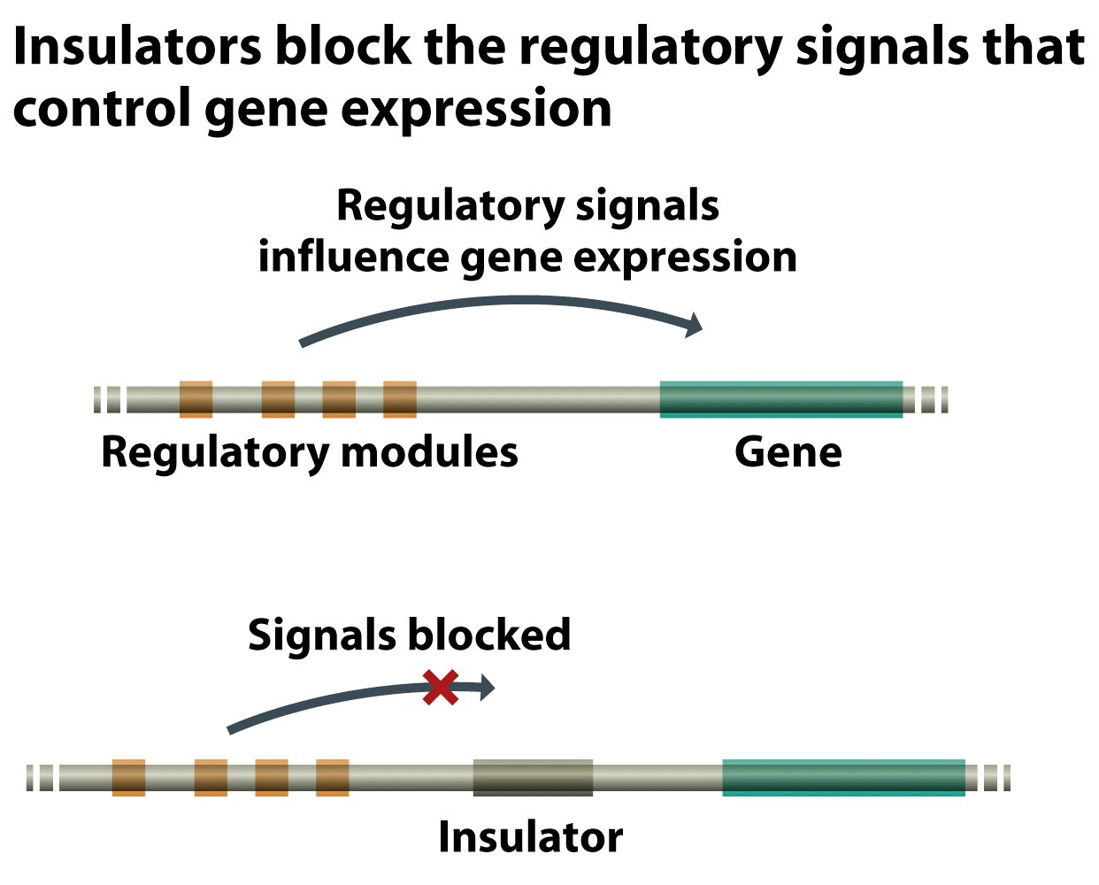
Figure 10.9a Genomes 3 (© Garland Science 2007)

Slide 12
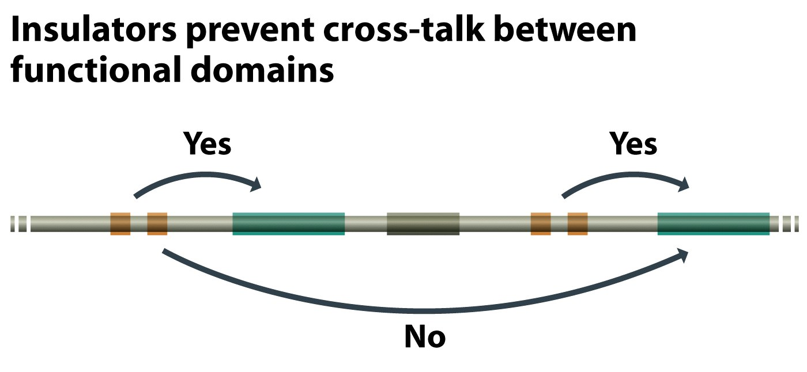
Figure 10.9b Genomes 3 (© Garland Science 2007)

Slide 13
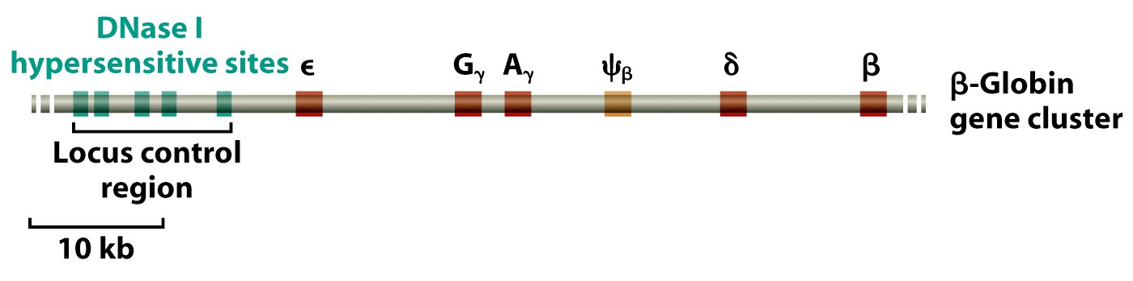
Figure 10.10 Genomes 3 (© Garland Science 2007)

Slide 14
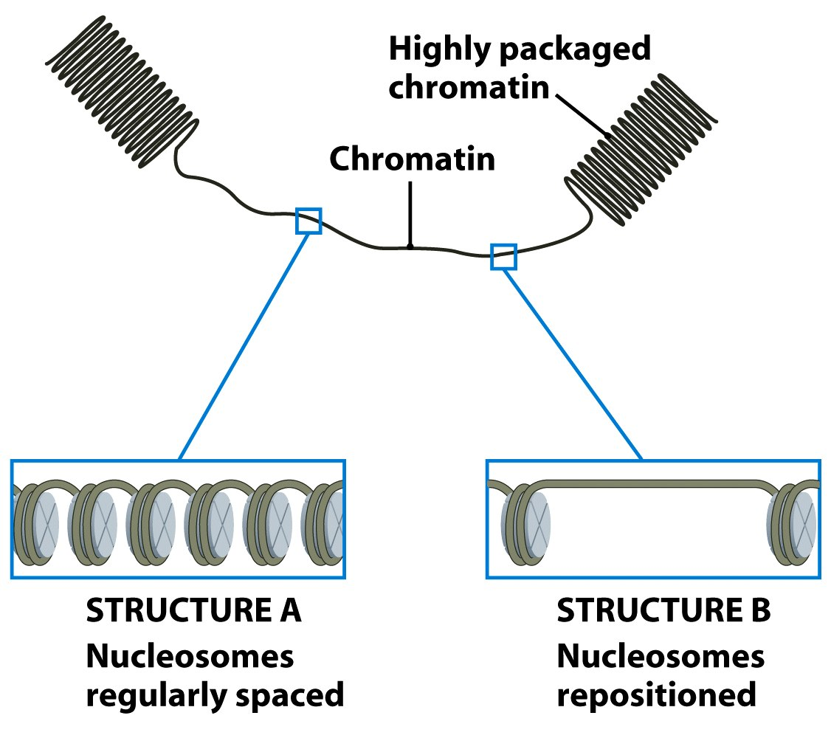
Figure 10.11 Genomes 3 (© Garland Science 2007)

Slide 15
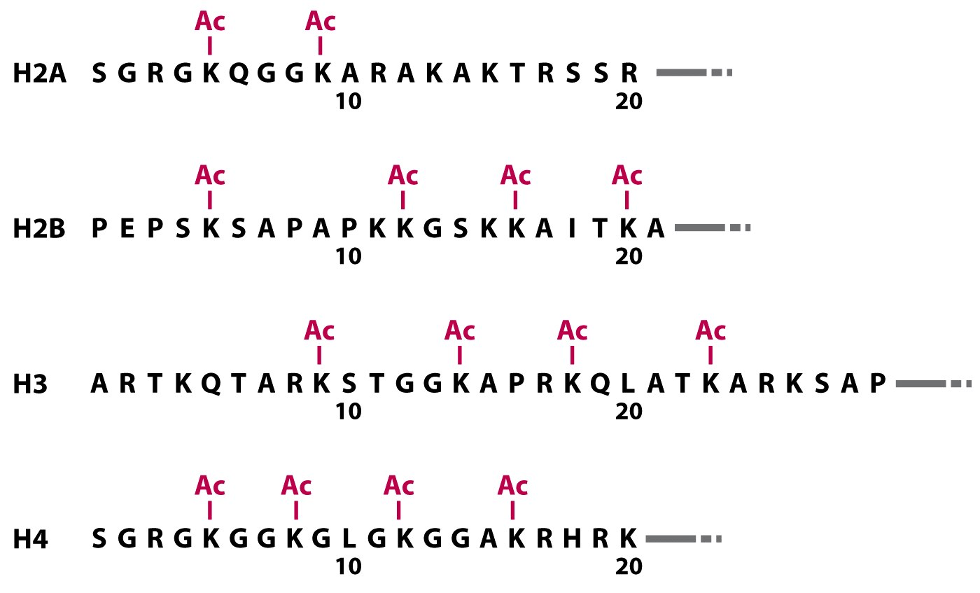
Figure 10.12 Genomes 3 (© Garland Science 2007)

Slide 16
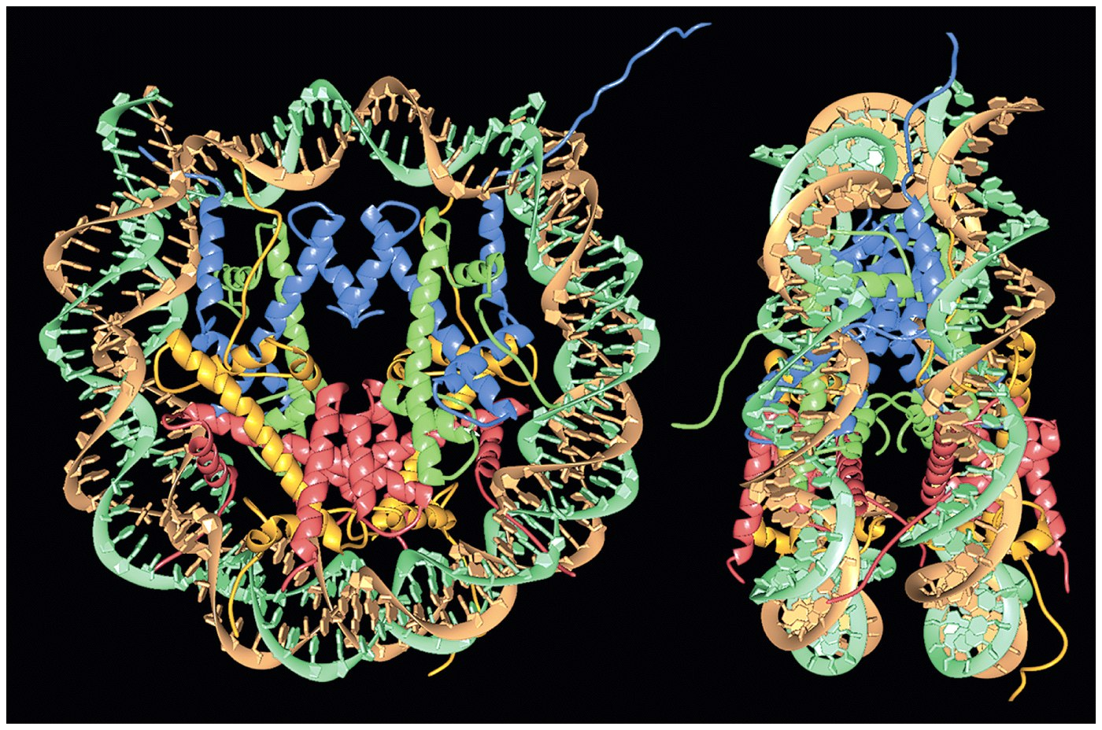
Figure 10.13 Genomes 3 (© Garland Science 2007)

Slide 17
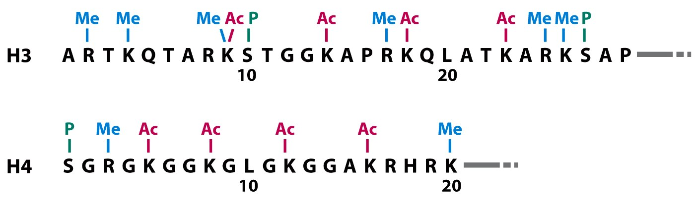
Figure 10.14 Genomes 3 (© Garland Science 2007)

Slide 18
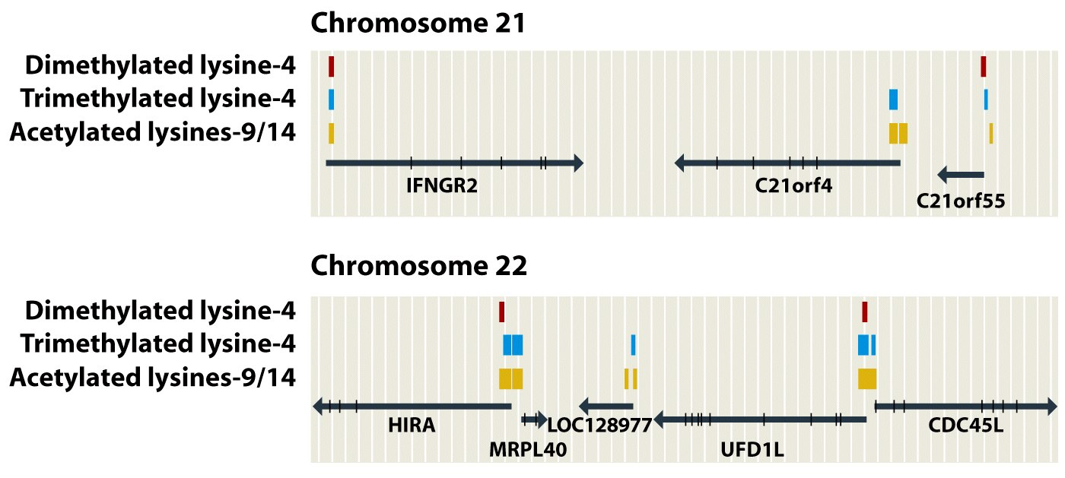
Figure 10.15 Genomes 3 (© Garland Science 2007)

Slide 19
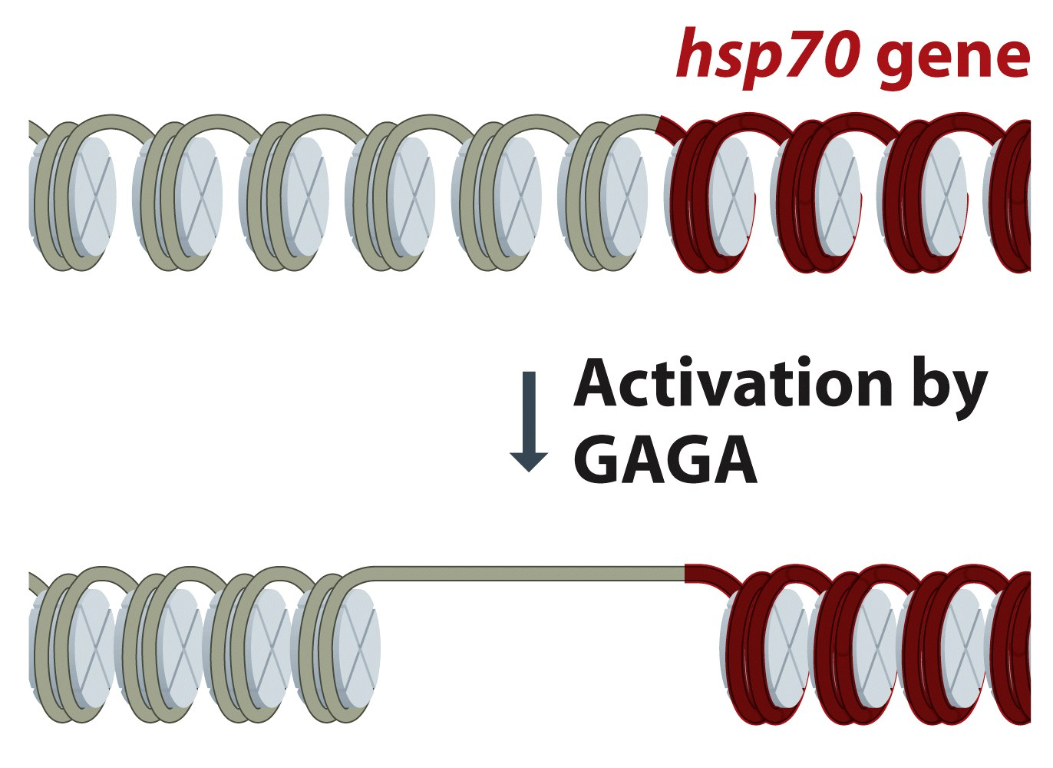
Figure 10.16 Genomes 3 (© Garland Science 2007)

Slide 20
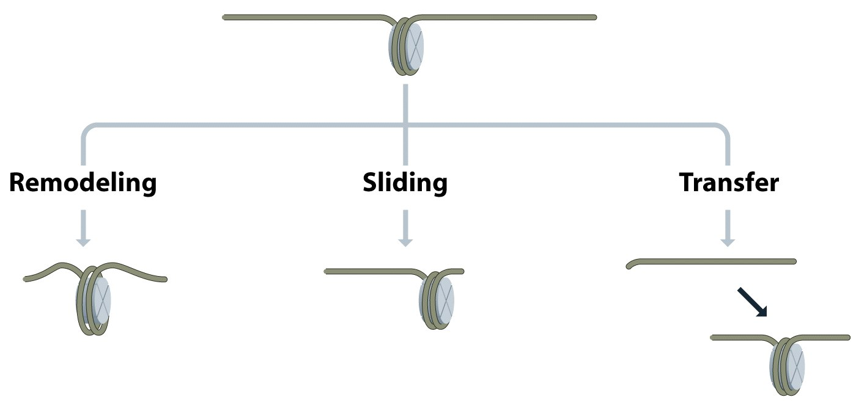
Figure 10.17 Genomes 3 (© Garland Science 2007)

Slide 21
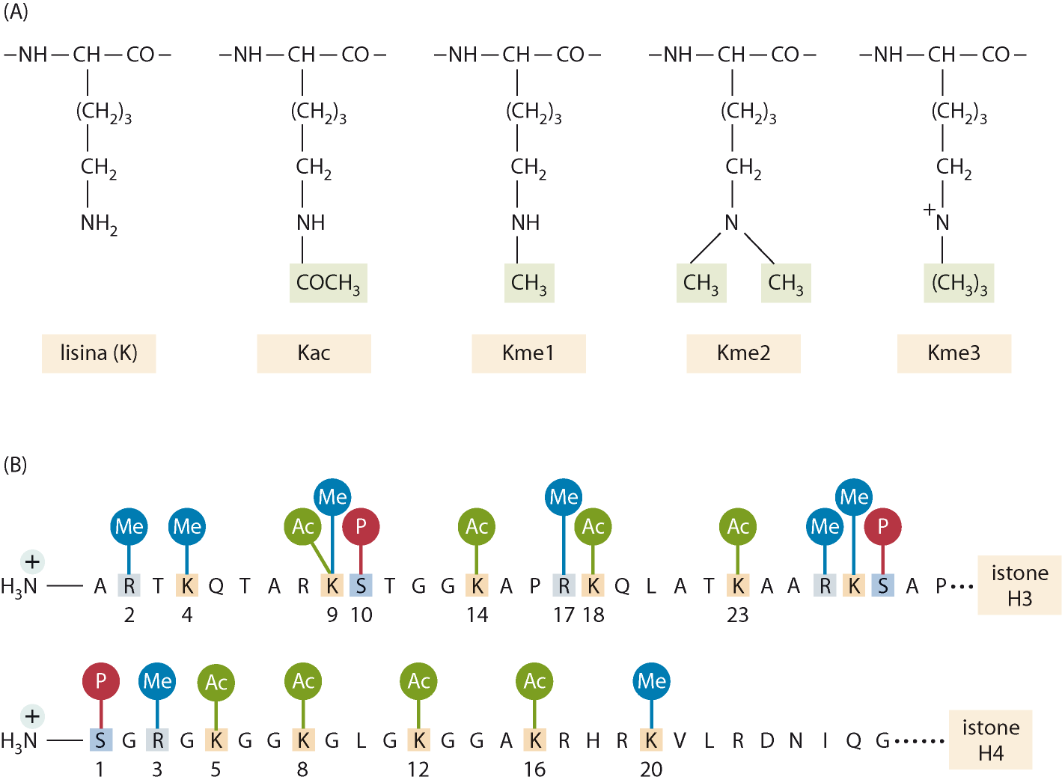

Slide 22
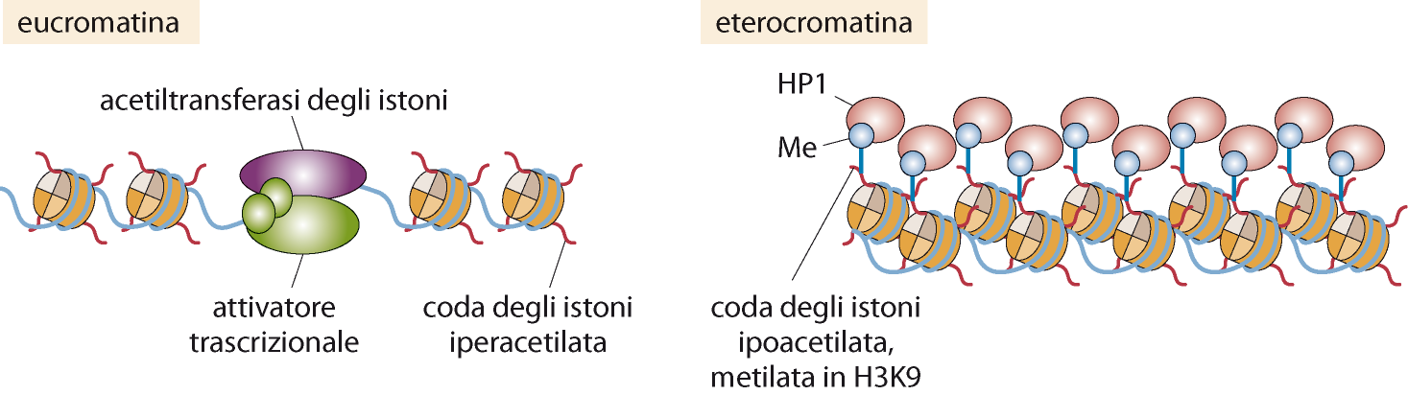

Slide 23
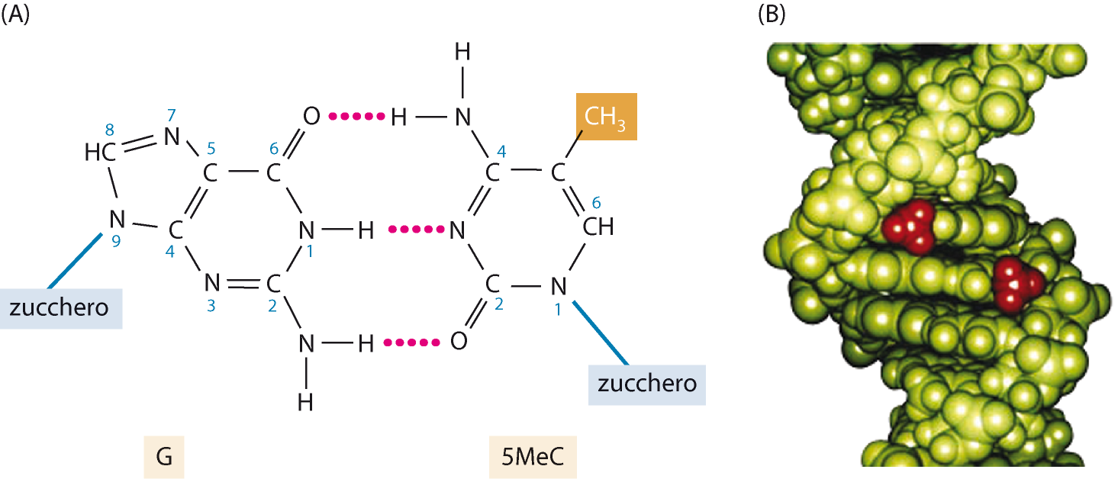

Slide 24
