Slide 1
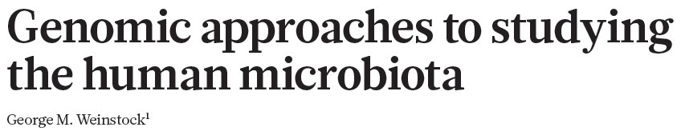
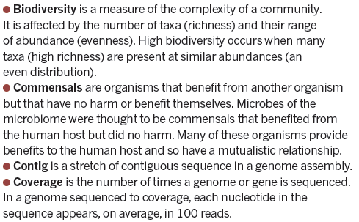
H = -Σpi log2 pi

Slide 2
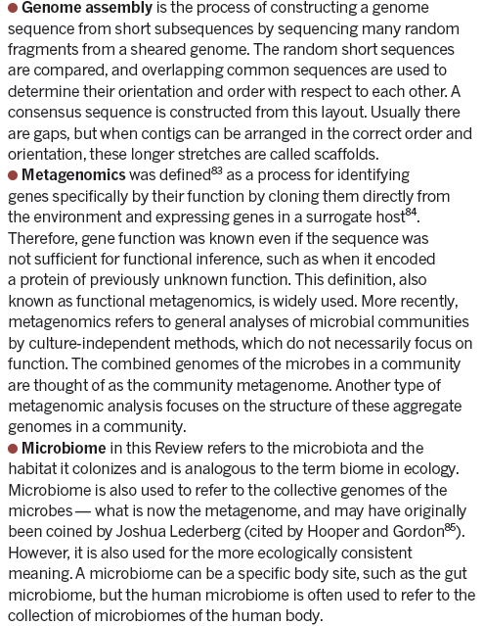

Slide 3
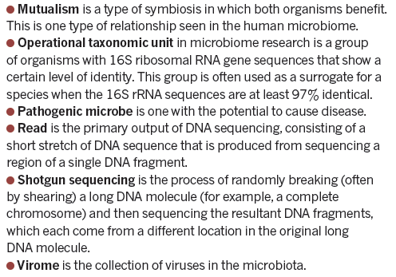

Slide 4
SCOPI
Each one of the many microbial communities has its own structure and ecosystem, depending on the body environment it exists in.
The fundamental goal of human microbiome research is to measure the structure and dynamics of microbial communities, the relationships between their members, what substances are produced and consumed, the interaction with the host, and differences between healthy hosts and those with disease.
Despite an explosion in human-microbiome research, these communities are still the dark matter of the body.
The complexity of microbial communities makes studying them challenging. There may be hundreds of different species, and enumerating what organisms are present with standard microbiological techniques is not possible because many organisms have never been grown in culture and may require special, as yet unknown, growth conditions.
In addition, the abundance of some microbes can range over orders of magnitude, so deep sampling is required to detect the less-abundant members. Culture-independent methods of taking a microbial census…………

Slide 5
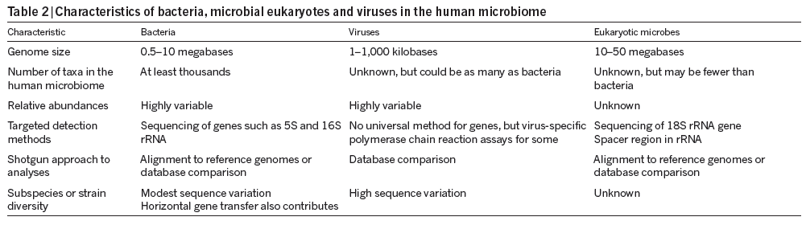
ECOLOGIA: SIMBIOSI + MUTUALISMO + PARASSITISMO
Every community of the microbiome has its own characteristics .
Microbial communities benefit the host by providing functions such as digestion of nutrients or protection against infection.
Antibiotic treatment perturbs the microbiome by reducing its size and altering its composition. This disturbance can lead to infection, and antibiotic-resistant organisms such as Clostridium difficile — normally controlled by the microbiome — can overgrow and create problems.
More complex community contributions also exist, such as interactions with host immune and inflammatory systems2

Slide 6
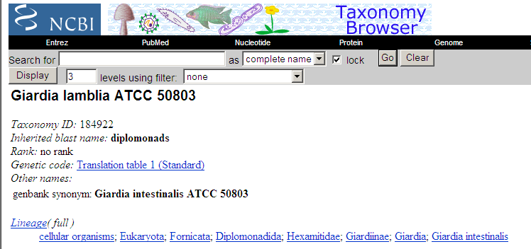
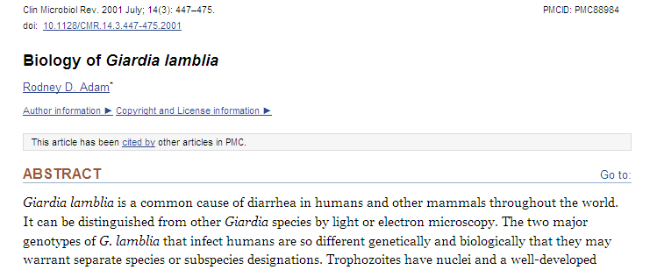

Slide 7
TARGETED METHODS
Modern metagenomic analyses of microbial communities were developed from culture-independent methods for taking a census of organisms present in a community and their abundances.
Sequencing of 16S rRNA genes is the main method of taking a community census because fingerprinting methods do not adequately measure low-abundance organisms
16S rRNA differs for each bacterial species. A bacterial species is hard to define, but is often taken as organisms with 16S rRNA gene sequences having at least 97% identity — an operational taxonomic unit (OTU).
Introducing NGS to 16S rRNA gene analysis led to marked improvements in cost and depth of sampling. The Roche–454 platform has dominated microbial community analysis31. As the read length for 454 pyrosequencing is about 400 bases, only a portion of the 16S rRNA gene can be sampled, and many different studies have targeted between one and three of the hypervariable regions

Slide 8
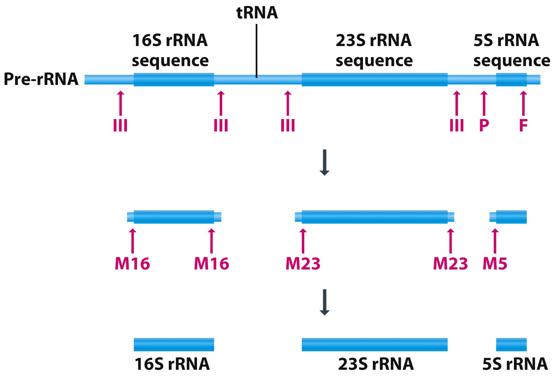
Figure 12.16 Genomes 3 (© Garland Science 2007)

Slide 9
When using 16S rRNA gene sequencing to compare individuals it is not necessary to know which organisms are present, only whether the spectra of 16S rRNA gene sequences are similar and the degree of difference between samples.
Projects that compare healthy cohorts and those with disease to determine whether there is a difference in the microbiome, or examine the effects of diet, antibiotic treatment or environmental factors on the microbiome, all focus on detecting differences in communities, rather than identifying actual taxa.

Slide 10
SHOTGUN METHODS
Targeted sequencing is a powerful tool for assessing the organisms that are present in microbial communities, but it is limited in terms of the functional and genetic information produced.
Organisms for which the genome sequences are known (currently there are several thousand sequenced bacterial genomes) can be used to infer the genes and functional capabilities of the community. However, many organisms have no reference sequence.
Furthermore, a reference sequence does not completely describe the genes that are contributed by an organism. There is considerable variation in the genomes between strains of the same species. Two strains of Escherichia coli, O157:H7 and K-12, both have 16S rRNA gene sequences of E. coli, but differ in hundreds of genes.
Moving beyond this level of functional inference requires a gene-based census. This catalogue of genes can be provided by shotgun sequencing of DNA that has been extracted from the community as a whole and samples the mixture of genomes that make up the metagenome

Slide 11
Illumina sequencing of faecal samples produced 4 gigabases per sample and 10 Gb per sample in the Metagenomics of the Human Intestinal Tract (MetaHIT) and HMP projects, respectively, which corresponded to tens of millions of reads per sample.
At this depth of sequencing, the genomes of minor constituents such as E. coli (with an abundance of about 1% or lower) are sampled almost completely, and organisms with an even lower abundance have some of their genome represented.
Shotgun sequencing is less sensitive than targeted rRNA sequencing because a small fraction of the sequences are from 16S rRNA genes.
Another approach is to align shotgun sequences to bacterial reference genomes33,40,41, allowing the relative abundance of species to be determined on the basis of the number of reads that align to each reference genome.
The main limitation of using shotgun data is the large number of organisms that have not been cultured, let alone sequenced. These organisms are therefore under-represented in databases, and their shotgun reads are anonymous.

Slide 12
COMPUTATIONAL TOOL – 3 PHASES
1. In the first phase, primary data are processed and filtered depending on the application.
Initial processing addresses read quality, chimaerism (a read formed from different 16S rRNA genes), read length after removing low-quality bases and related issues.
2. the second phase involves generating various derivative data sets. For 16S rRNA gene analysis, tables of taxa and abundance are produced by comparisons with 16S rRNA sequence databases.
Alignment of reads to reference genomes produces tables of breadth and depth of coverage, by reads of each genome.

Slide 13
3. The third phase of analysis uses these derivative data to produce trees or other representations of the similarity of communities, abundance curves, biodiversity plots, and other ecological and statistical descriptors of community structure.
A list of hits from BLAST is used to build metabolic pathways for reconstruction of community capabilities. Alignments to reference genomes are further analysed for variants and population genetics of communities.
Computational analysis can also be used to determine which organisms co-occur or rarely co-occur as evidence for symbiosis or competition, respectively, or to follow the dynamics of community structure in longitudinal time series.

Slide 14
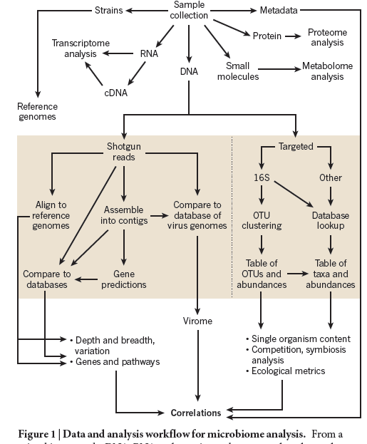

Slide 15
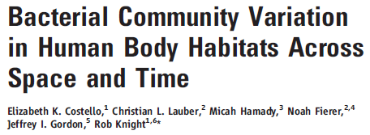
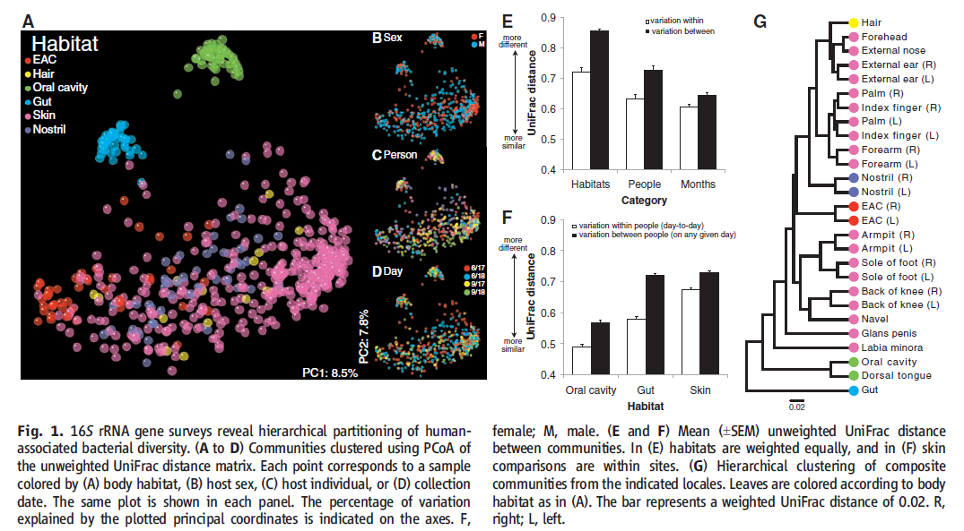

Slide 16
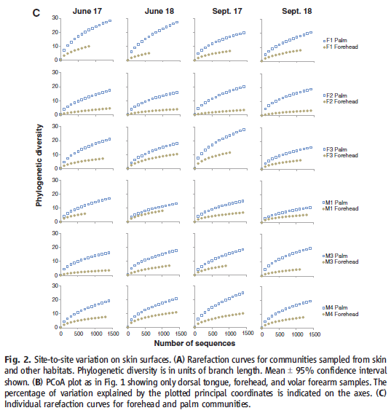

Slide 17
